Slide 1
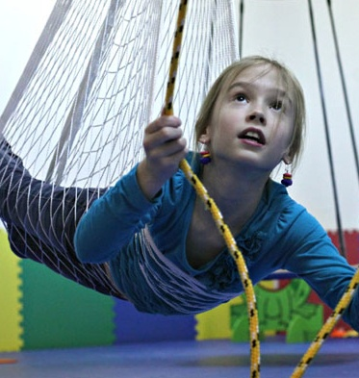
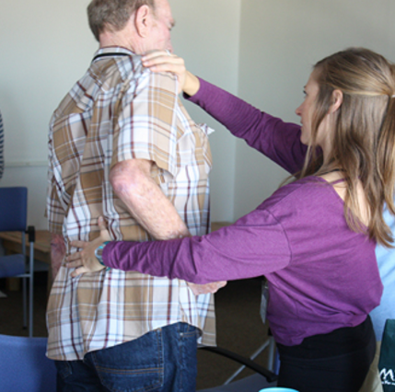

Visualization of Research in Occupational Therapy
Based on 1982-2016 Data from the American Occupational Therapy Foundation

Slide 2
Visualization Team
introduction
For several years, the American Occupational Therapy Foundation, in partnership with the American Occupational Therapy Association, has built up a researcher database to track research on Occupational Therapy techniques and practices. 438 research projects have been recorded, spanning research from 1982 through 2016. The intent of this data is to create a comprehensive understanding of the scientific community for building scientific networks, identifying scientific leaders for specific initiatives, and summarizing capacity to external stakeholder groups. This report provides several visualizations of that data to provide insights to help realize this vision, and provide guidance for larger analysis of research data.
Five Visualization Types were created for this analysis:
Topical – this explores the research topics in the data to understand topic space of the research.
Geospatial – Provide insights on where the research is done and possible research linkages between locations.
Temporal – This shows the evolution of topics over time and where bursts of activity have occurred.
Network – Identifies key topic areas with researchers, and shows how this has evolved over time.
Data Explorer – Provides an on-line tool to quickly see research by location and topic areas. This will help researchers further explore and understand the insights from the other visuals provided.
Peter Annable Cincinnati, OH pannable@iu.edu
Rose Rahman Denver, CO rosrahma@iu.edu
Shahzad Saleem Minneapolis, MI saleems@iu.edu
Mahesh Suravajjala Salt Lake City, UT msuravaj@iu.edu
Helen Yezerets Columbus, IN yyezeret@iu.edu
Indiana University Information Visualization I590

Slide 3
Table of Contents
Executive Summary
Topical Visualization
Geospatial Visualization
Temporal Visualization
Network Visualization
Data Explorer
Notes on Data Preparation
Limitations of Analysis

Slide 4
Executive Summary of Insights
Total research has grown dramatically year over year, especially after year 2000.
Seven institutions have received 80% of total funding dollars: University of Pittsburgh, Thomas Jefferson University, University of Southern California, University of North Carolina – Chapel Hill, Colorado State University, University of Buffalo and University of Texas Medical Center
While research connected Strokes is the largest overall, research related to Autism spectrum disorders has grown from none in early years to now being the top diagnosis area.
Autism research is strongly connected with Sensory Disorders. Stroke with Cerebral Palsy.
Add note about connections between research institutions.

Slide 5
Topical Analysis
Visualization Objective
To xxxx...
How to Interpret
The dataset was thoroughly cleansed, removed Null values. All keyword fields combined to make one field, which was converted to a Word Cloud. The largest words are the most mentioned in total across all research.
Key Insights
Major group of topics discovered during the analysis are “Stroke Rehabilitation”, “Autism”, “Sensory Processing” and “Spinal Cord Injury”.
Common topics related to children are Spinal cord Injury, Autism and Autistic Disorder. On the other hand more topics related to older Adults are Sensory Processing, self-care and Depression.
Research topics found are on Stoke rehabilitation, Early Intervention training outcome. Stroke Rehabilitation is THE major topic found throughout

Slide 6
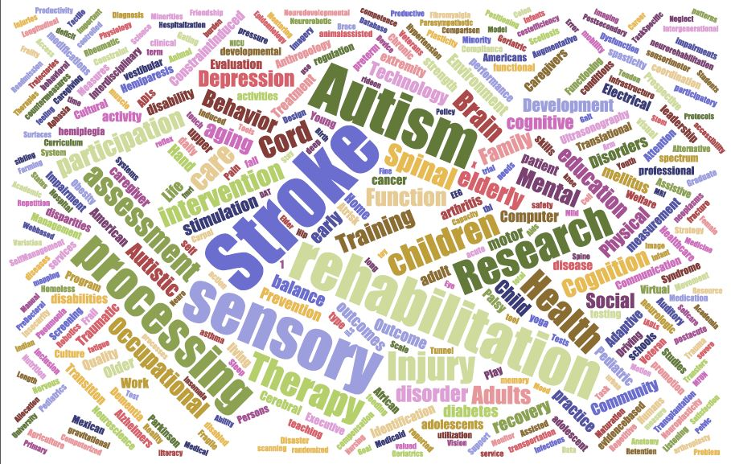
topical analysis – Word CLOUD

Slide 7
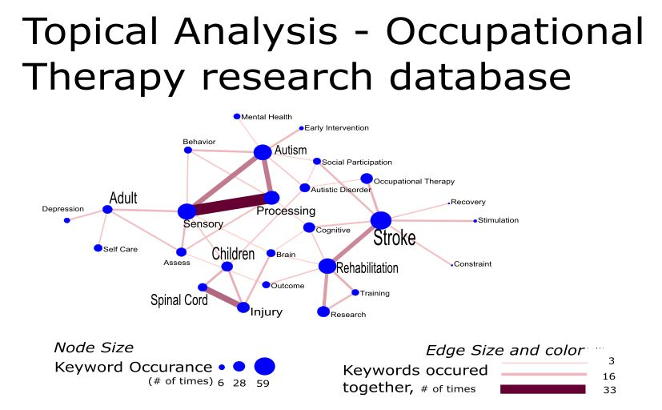
topical analysis – Keywords Network

Slide 8
Geospatial Analysis
Visualization Objective
The proportional symbol map is used to map total research activity by institution location and visualize the potential collaboration links among them. This provides a quick way to understand total research funding and number of projects by location, and relative ranking between institutions.
How to Interpret
Highlighted states contained at least one institution performing research. The size of the nodes represents the total funding amount from 1982 through 2016. The color of the nodes represents the number of research projects that have been conducted by the institutions. The color of the circles around the nodes represent the number of researchers within the institutions.
Key Insights
The five major players in the occupational therapy research, based on total amount of funding, are University of Pittsburgh, Thomas Jefferson University, University of Southern California, University of Chapel Hill, and Colorado State University.
These five institutions also ranked highest in the number of research projects and the number of researchers.
Potential collaborations can be visually projected by identifying the size of the nodes that represent the institutions.

Slide 9
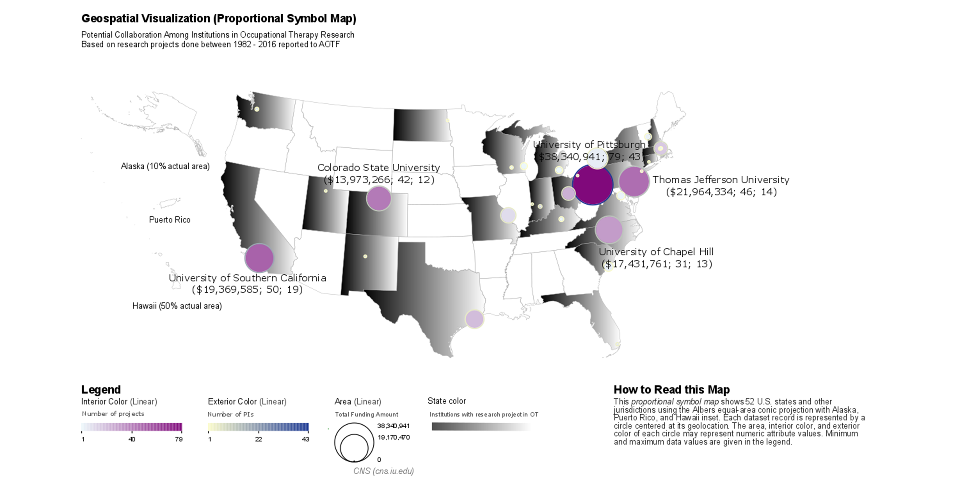

Slide 10
Temporal Visualization
Visualization Objective
abc
How to Interpret
abc
Key Insights
The…

Slide 12
Network Analysis
Visualization Objective
Abc
How to Interpret
The dataset was thoroughly cleansed, with duplicate records removed. The referential integrity was enforced on the clean dataset. The Primary Investigator was associated with the Diagnosis Descriptions relative to the respective Research Projects. The extracted dataset was cumulatively sliced by seven years from 1982 to 2016 inclusively.

Slide 13
Primary investigator vs. diagnosis network
Key Insights
For every time slice the number of nodes tripled from 18 in 1989 to 221 in 2016.
From 1982 to 1996 the research was concentrated on Amputations or limb loss, Other, and Dementia or Alzheimer's disease Diagnosis with M. Lowler and J.Rogers consistently leading the research in the respective areas, including on the Other Diagnosis.
From 2003 to 2016 the field of research expanded significantly and started moving to the areas of Autism spectrum disorders, lead by Teresa A. May-Benson, that is strongly connected to Sensory integration/processing disorders research community that was headed by Patricia Davies. The third largest, Stroke research community, is connected to the Other diagnosis by Kenneth Ottenbacher and is engaged in collaborations with Brain injury and disorders and Cerebral Palsy.
Two more dispersed communities were identified. The first consisted of the area of diagnosis associated with various body injuries such as Spinal Cord, Upper Extremities and Musculoskeletal injuries with Corey McGee and Mary Jane Mulcahey leading the field. The second emerging community consists of Mental illness, Diabetes and Cardiopulmonary conditions field lead by Christine Helfrich.

Slide 14
Cumulative Network of Diagnosis vs. Primary Investigators
1982-2017
The dataset was thoroughly cleansed, with duplicate records removed. The referential integrity was enforced on the clean dataset. The Primary Investigator was associated with the Diagnosis Descriptions relative to the respective Research Projects. The extracted dataset was cumulatively sliced by seven years from 1982 to 2017 inclusively.
For every time slice the number of nodes tripled from 18 in 1989 to 221 in 2017.
From 1982 to 1996 the research was concentrated on Amputations or limb loss, Other, and Dementia or Alzheimer's disease Diagnosis with M. Lowler and J.Rogers consistently leading the research in the respective areas, including on the Other Diagnosis.
From 2003 to 2017 the field of research expanded significantly and started moving to the areas of Autism spectrum disorders, lead by Teresa A. May-Benson, that is strongly connected to Sensory integration/processing disorders research community that was headed by Patricia Davies. The third largest, Stroke research community, is connected to the Other diagnosis by Kenneth Ottenbacher and is engaged in collaborations with Brain injury and disorders and Cerebral Palsy.
Two more dispersed communities were identified. The first consisted of the area of diagnosis associated with various body injuries such as Spinal Cord, Upper Extremities and Musculoskeletal injuries with Corey McGee and Mary Jane Mulcahey leading the field. The second emerging community consists of Mental illness, Diabetes and Cardiopulmonary conditions field lead by Christine Helfrich.

Slide 15
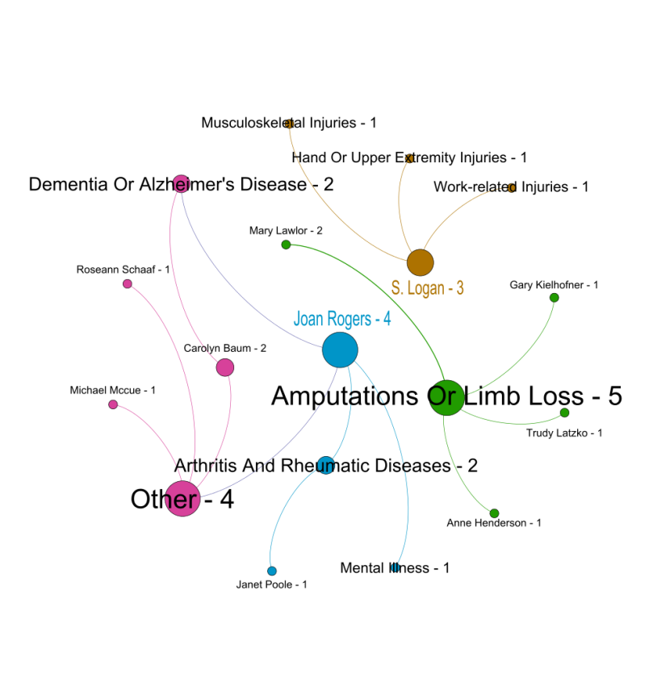
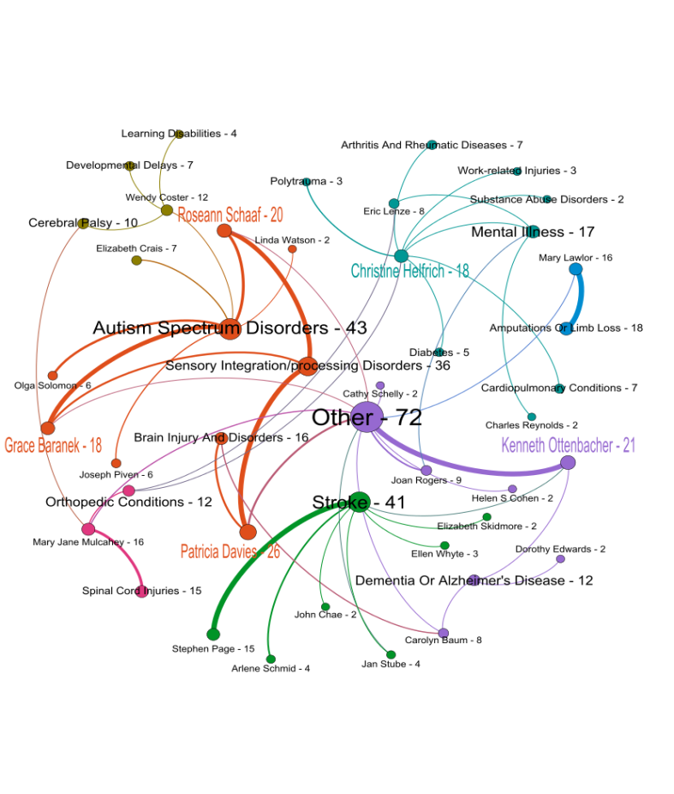
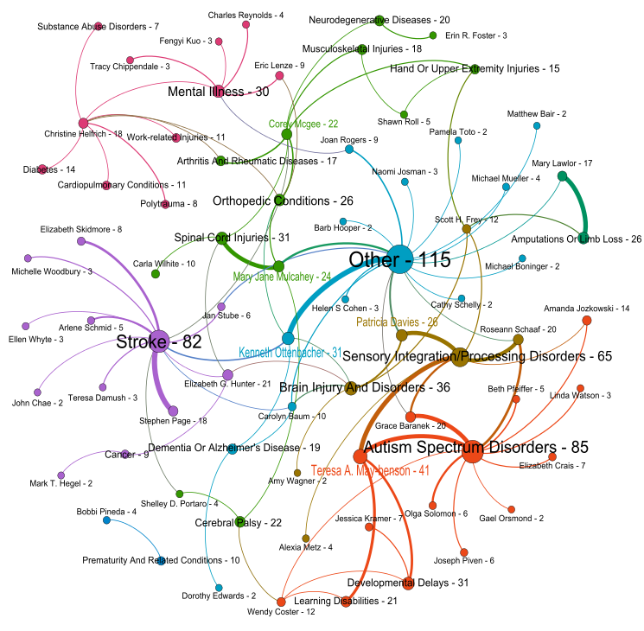
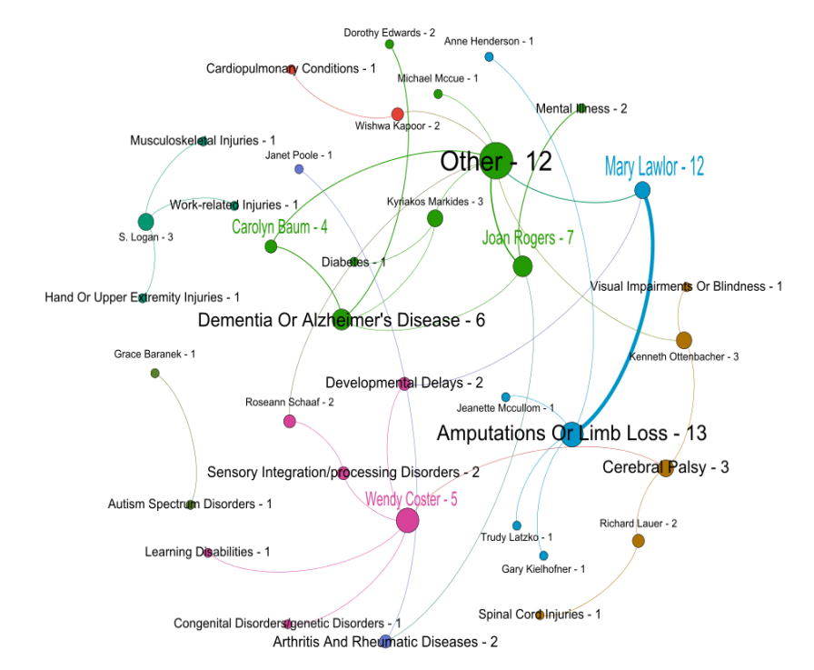
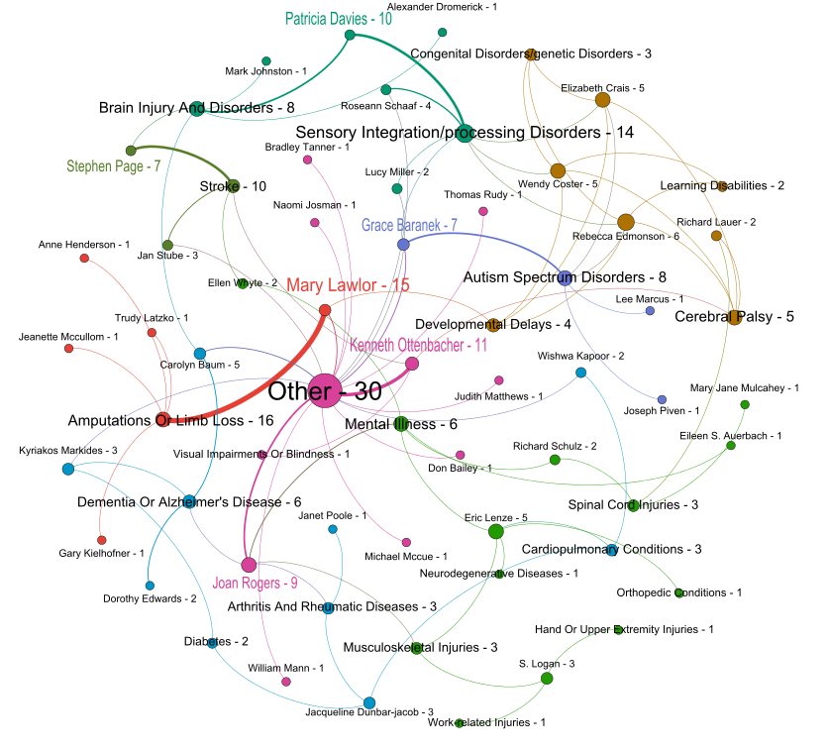
1982-1989
Cumulative Network of
Diagnosis vs. Primary Investigators
1982-2017
1982-2010
1982-1996
1982-2003
Nodes and Edges colorized by communities
Nodes , Node Labels and Edges sized by number of projects
Labels depict PI name or Diagnosis and a number of associated projects
Top 5 PIs with the most number of research projects colored

Slide 16
Cumulative Network of Diagnosis vs. Agenda
1982-2017
The Agenda vs. Diagnosis dataset was cumulatively sliced by seven years from 1982 to 2017 inclusively.
Number of projects steadily grew from 7 in the period of 1982-1989 (to 22, to 75, to 148) to 278 in the period of 1982-2017. Started with only eight Diagnoses, the field significantly expended to 29 Diagnoses by 2017.
Basic Research, Assessment/measurement and Intervention-preventive Agendas were strongly represented by a majority of the associated research projects
After 1996 a new agenda item (Research Training) was introduced.
Initially, Basic Research, Assessment/measurement agendas were strongly linked with Amputations or limb loss, Other, and Dementia or Alzheimer's disease Diagnoses .
After 1996 Autism spectrum disorders, Sensory integration/processing disorders and Stroke Diagnoses associated with Intervention-preventive Agenda started playing prominent role in the OT community

Slide 17
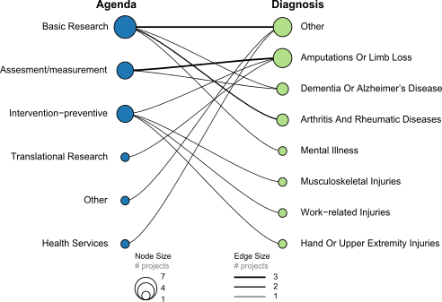
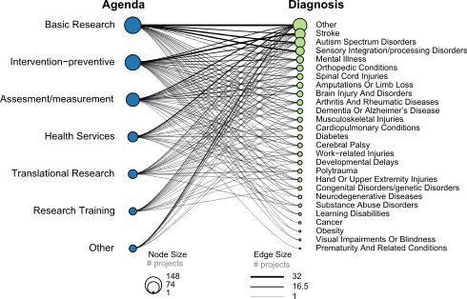
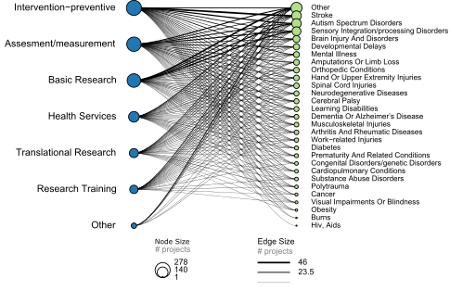
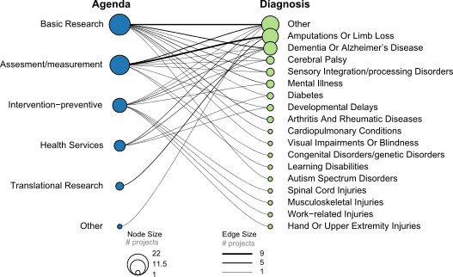
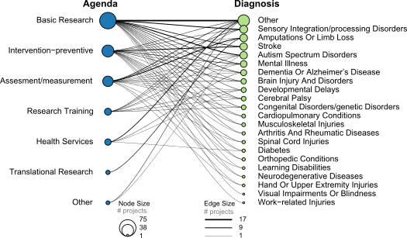
1982-1989
Cumulative Network of
Agenda vs. Diagnosis
1982-2017
1982-2010
Agenda Diagnosis
1982-1996
1982-2003

Slide 18

Cumulative Time Slice
1982-1989
Primary investigator -diagnosis
Agenda-diagnosis

Slide 19

Cumulative Time Slice
1982-1996
Primary investigator -diagnosis
Agenda-diagnosis

Slide 20
Cumulative Time Slice
1982-2003
Primary investigator -diagnosis
Agenda-diagnosis

Slide 21

Cumulative Time Slice
1982-2010
Primary investigator –diagnosis
(2 and more projects only)
Agenda-diagnosis

Slide 22
Cumulative Time Slice
1982-2017
Primary investigator –diagnosis
(2 and more projects only)
Agenda-diagnosis

Slide 23
Data Explorer
Visualization Objective
Provide an easy to view specific research data organized by location and topic.
https://public.tableau.com/shared/6YQXKHBHY?:display_count=yes
How to Interpret
See the following slides for instructions on using each visualization

Slide 24
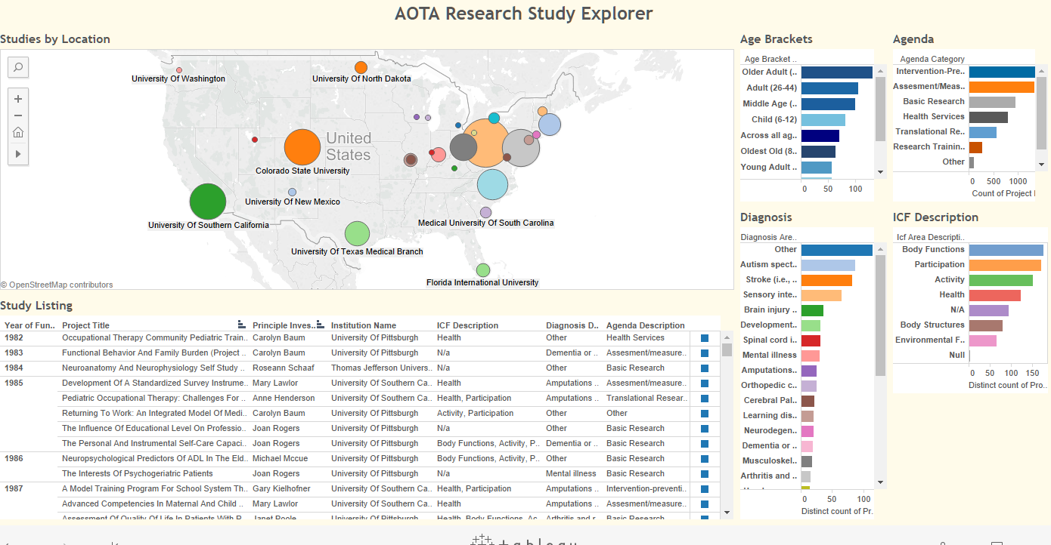
Study Explorer - How to Use
Click any colored shape to filter. Multiple Filters may be applied.
Click again to reset filter.
All views will update as filters are applied.
Hover on squares to see details of a study.

Slide 25
Notes about Data Preparation

Slide 26
Limitations of Analysis
Profile data was considered unreliable and not used in analysis.
Institution locations were not specified. These were determined by geocoding based on the main location of the institution.
Data, especially for earlier years, may not reflect all research done in this area.

